Slide 1
Introduction to Earth’s Resources

Slide 2
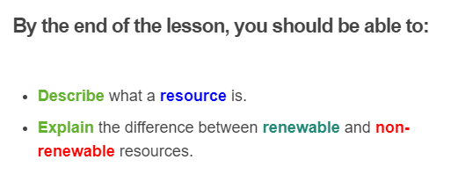


Slide 3

Let's see some examples of resources!
Rocks supply us with important things like minerals and fossil fuels.

Slide 4

Soil allows us to grow plants and food for farm animals.

Slide 5

Living things such as plants and animals can be eaten as food.

Slide 6

Renewable resources are resources which are replaced within the average human lifespan.
Renewable resources can be replaced in a reasonably short time. This means we should not run out of them as long as they are properly managed.

Slide 7
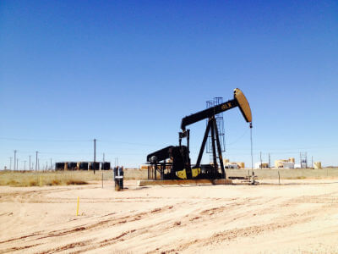
Non-renewable resources take a long time to be replaced.
This means that they can run out.
Some examples of non-renewable resources are rocks, soil, and fossil fuels.

Slide 8
Fossil fuels are a non-renewable energy source. Some fossil fuels are oil, coal, gas and their products (petrol and diesel).
Fossil fuels are converted to useful forms of energy such as electricity by being burnt. This releases large amounts of energy but also large amounts of the greenhouse gas carbon dioxide.
This increase in carbon dioxide is thought to contribute to climate change and global warming.
Renewable energy sources provide a sustainable way to use energy and limit greenhouse gas emissions.

Slide 9

You may have noticed that all resources can be replaced eventually.
Some resources just take longer to be replaced than others.
However, all resources can run out if they are used faster than they are replaced!

Slide 10
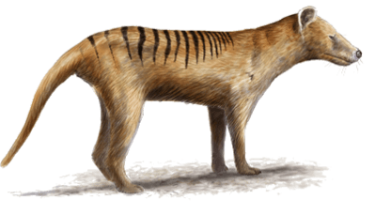
This is why some animals, such as the Tasmanian Tiger, have gone extinct even though they were a renewable resource.
They were killed faster than they could have more babies.

